Slide 1
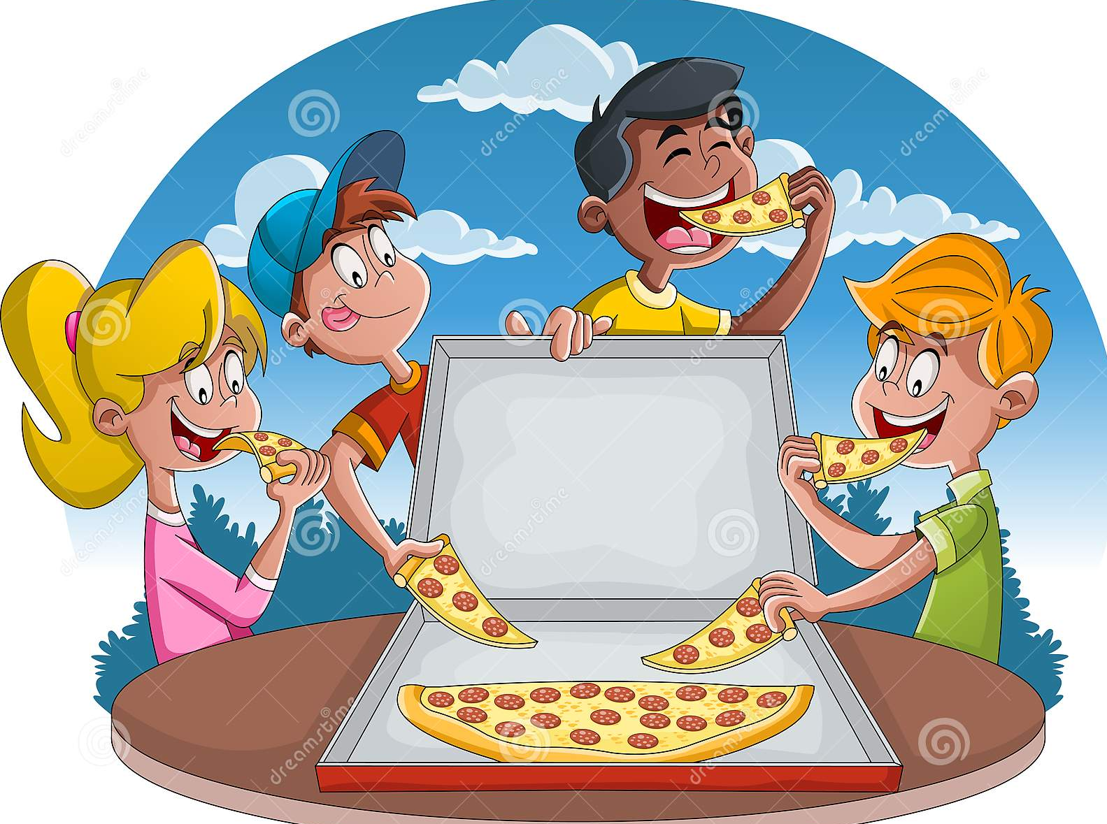
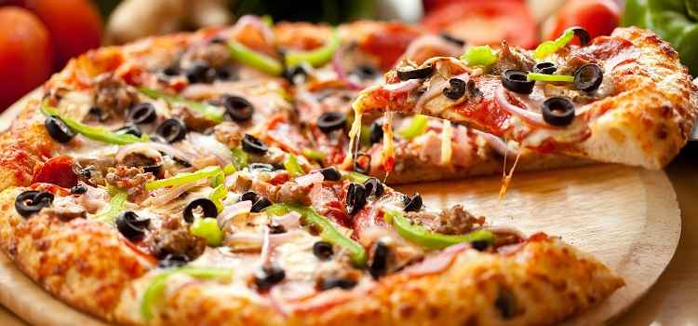
Pizza Order and billing Management System
Name -Shivam Saini
Uid- 21MCA2063
Section MCA1

Slide 2
Abstract
The main objective of the Pizza Ordering and billing Management System is to manage the details of the Item, pizza quantity, Price, Order, Bill. It manages all the information about Item Category, Some information of Customer. The project totally built in administrative end and thus only administrator is guaranteed the access. The purpose of the project is to build an application program to reduce the manual work for managing the Item, Category, Food, Customer. It track all the detail of the food item for the customer and prepare the bill automatically for Customer.

Slide 3
Introduction
Pizza ordering and billing Management System is a project which will help the restaurants in optimizing and controlling their restaurants. This project thus will help the restaurants to perform all the functionalities accurately and in a faster way. Therefore, the proposed Pizza Ordering System will help in reducing manual works and improve the efficiency of the restaurant. This project will help in maintaining the stock and cash flows. Moreover, there are many more functionalities that this project supports, like
To store records
Control orders and services.
Billing

Slide 4
Software tools we used
Dev C++
C++ language
OS Microsoft

Slide 5
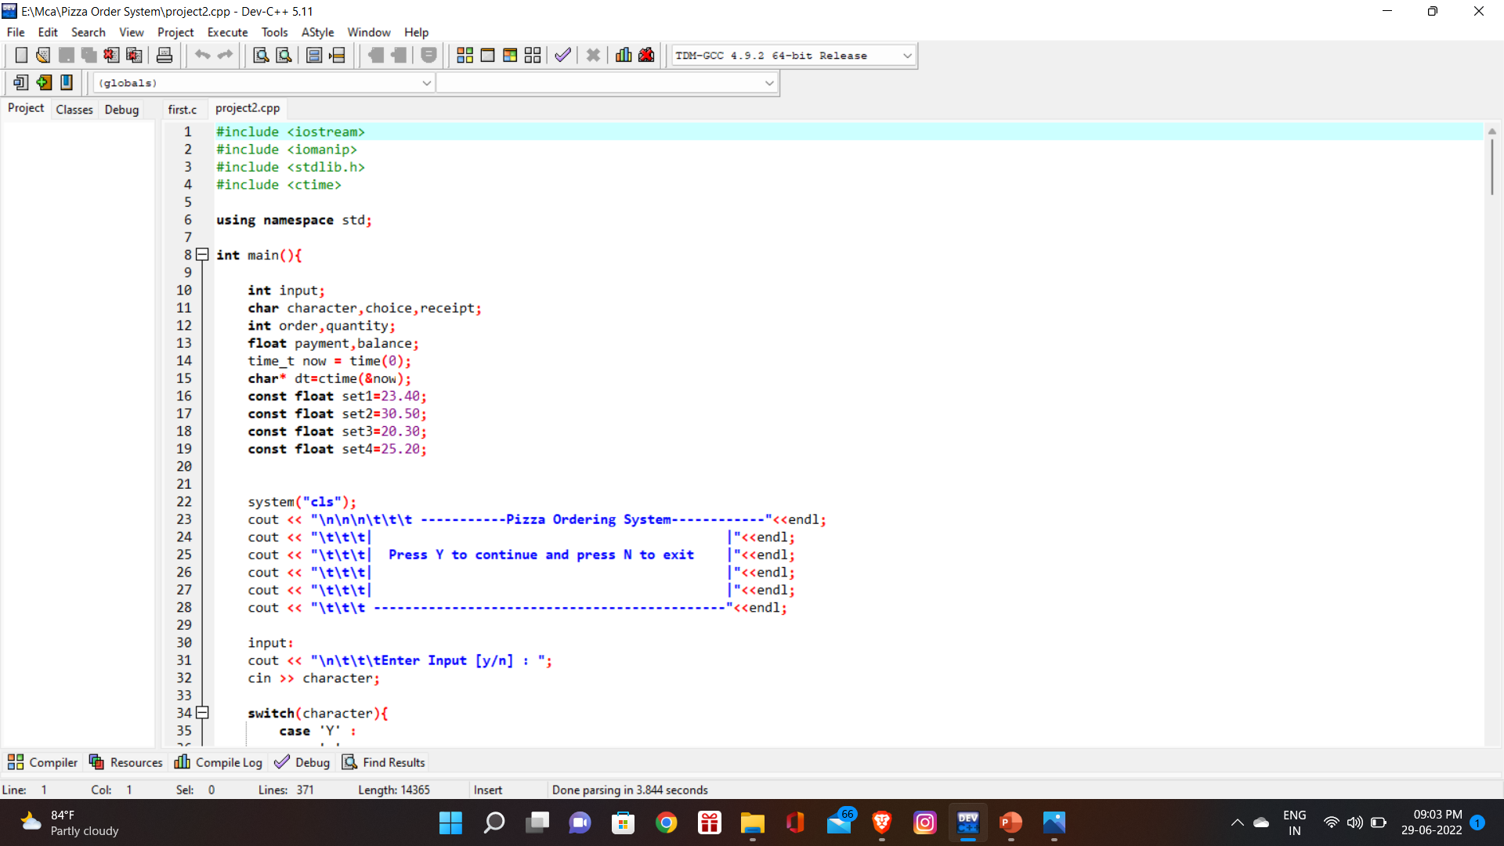
Source code
Header files we used :

Slide 6
Main function
In main function first we declare character array to hold the list of the Items.
Then we welcome with our opening line i.e. Pizzazone Ordering System welcome to Pizzazone
Then the software welcome the customer.
Then show the menu for the food and ask for the choice among 4 items.
Then this software will store the choice in option variable and proceed further.

Slide 7
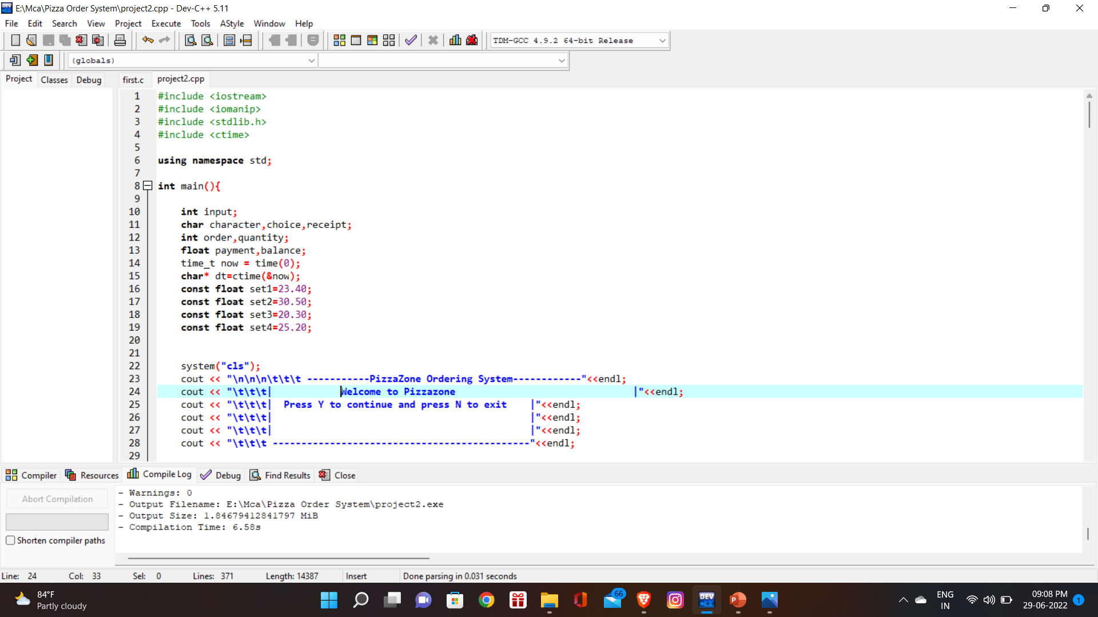
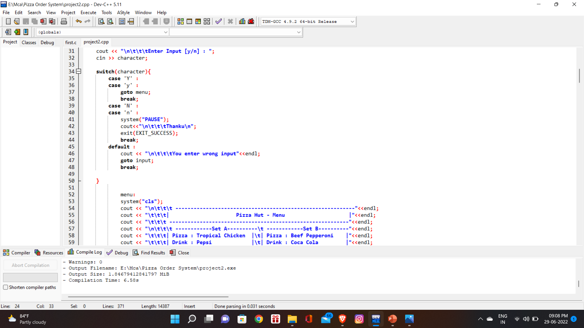
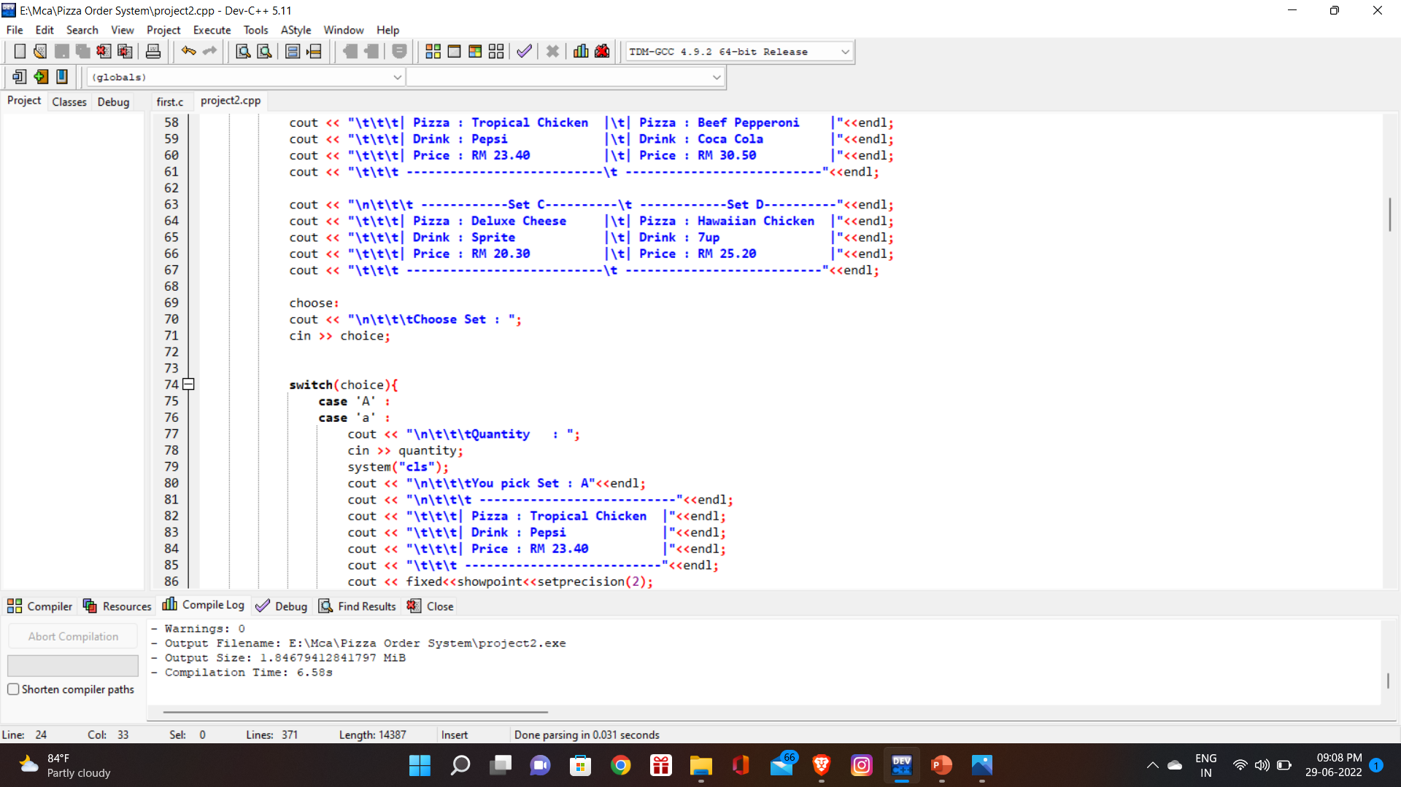
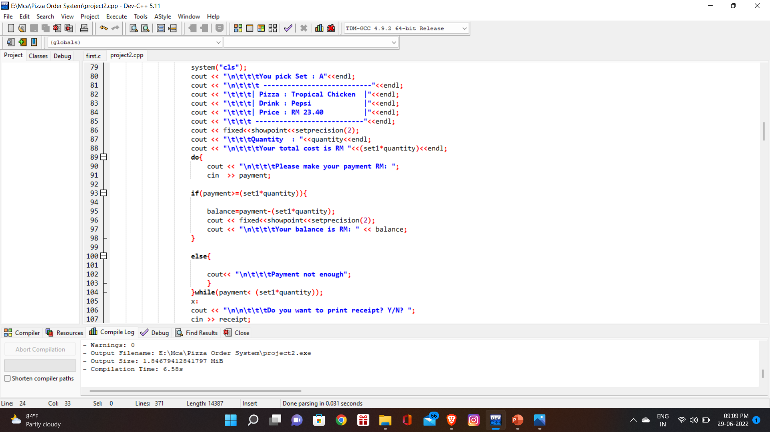

Slide 8
Main function
After having choice from the 4 Items, this software will further give the choice between different flavours of that item.
Then with this it will ask from the customer about the size and quantity of that flavour of the item and give the detail of price and display the time in which the order get delivered.
It will display the total bill to the customer for their order and ask more orders if customer want.
Same process will take place for all other items.

Slide 9
Description of the statements and functions we use in this application
A char is a C++ data type used for the storage of letters.
C++ Char is an integral data type, meaning the value is stored as an integer.
It occupies a memory size of 1 byte.
C++ Char only stores single character.
Char values are interpreted as ASCII characters

Slide 10
Description cont.
Loop used
For loop iterates a section of C++ code a fixed number of times. For loop runs as long as the test condition is true. The initialization part of for loop is for declaring and initializing any loop control variables. The condition part of for loop must be true for-loop body to be executed.
Inside loop order++ is called post-increment and will return the order then increment by 1 therefore return order value of 1
if else Statement used
Use if to specify a block of code to be executed, if a specified condition is true. Use else to specify a block of code to be executed if the same condition is false. Use else if to specify a new condition to test, if the first condition is false. Use else if to specify a new condition to test, if the first condition is false.
goto statement used
A goto statement provides an unconditional jump from the goto to a labelled statement in the same function. It performs a one-way transfer of control to another line of code; in contrast, a function call normally returns control.

Slide 11
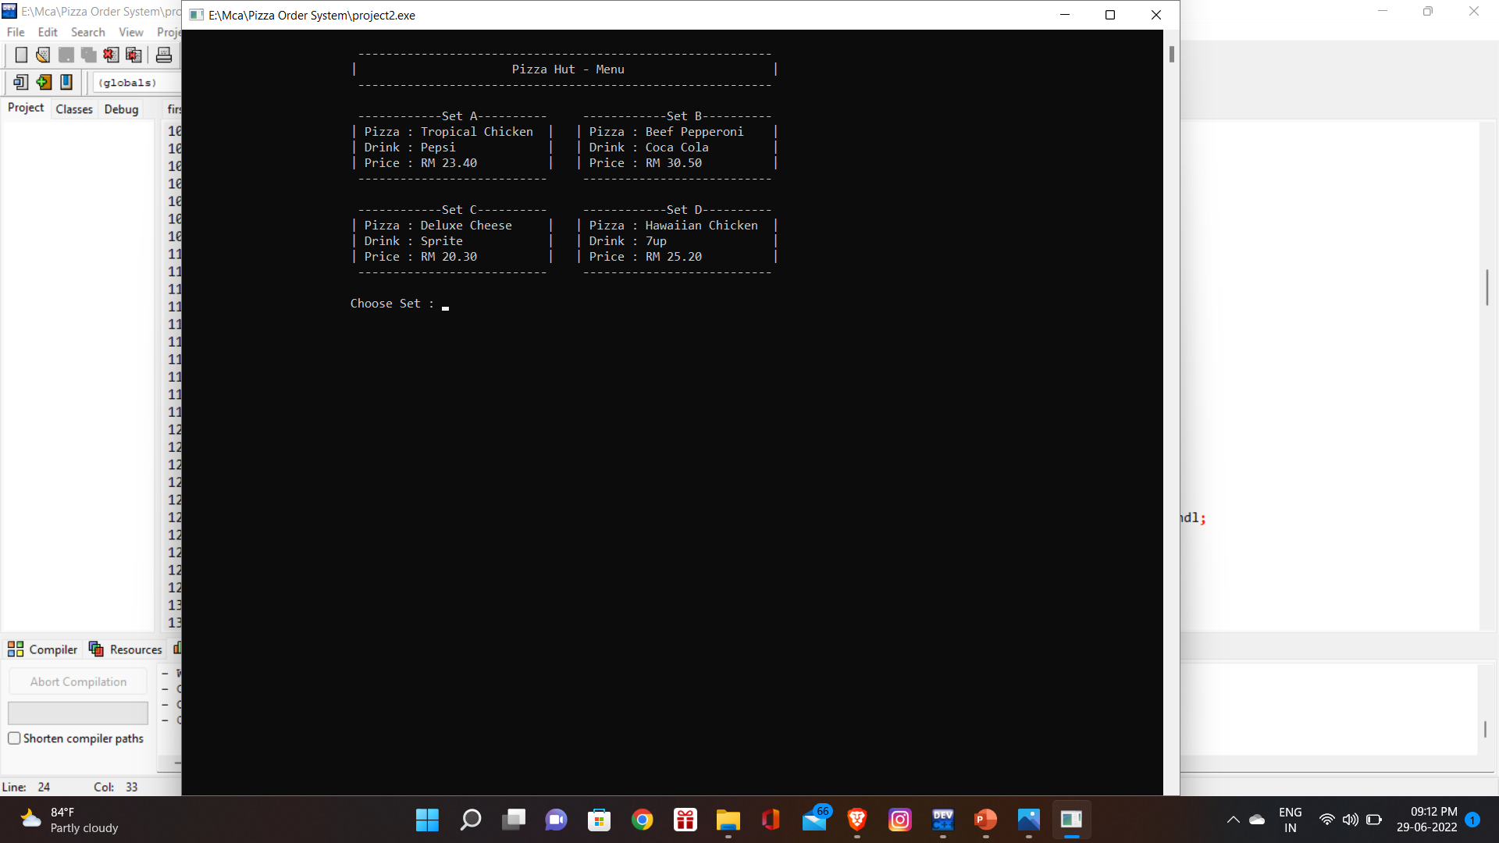
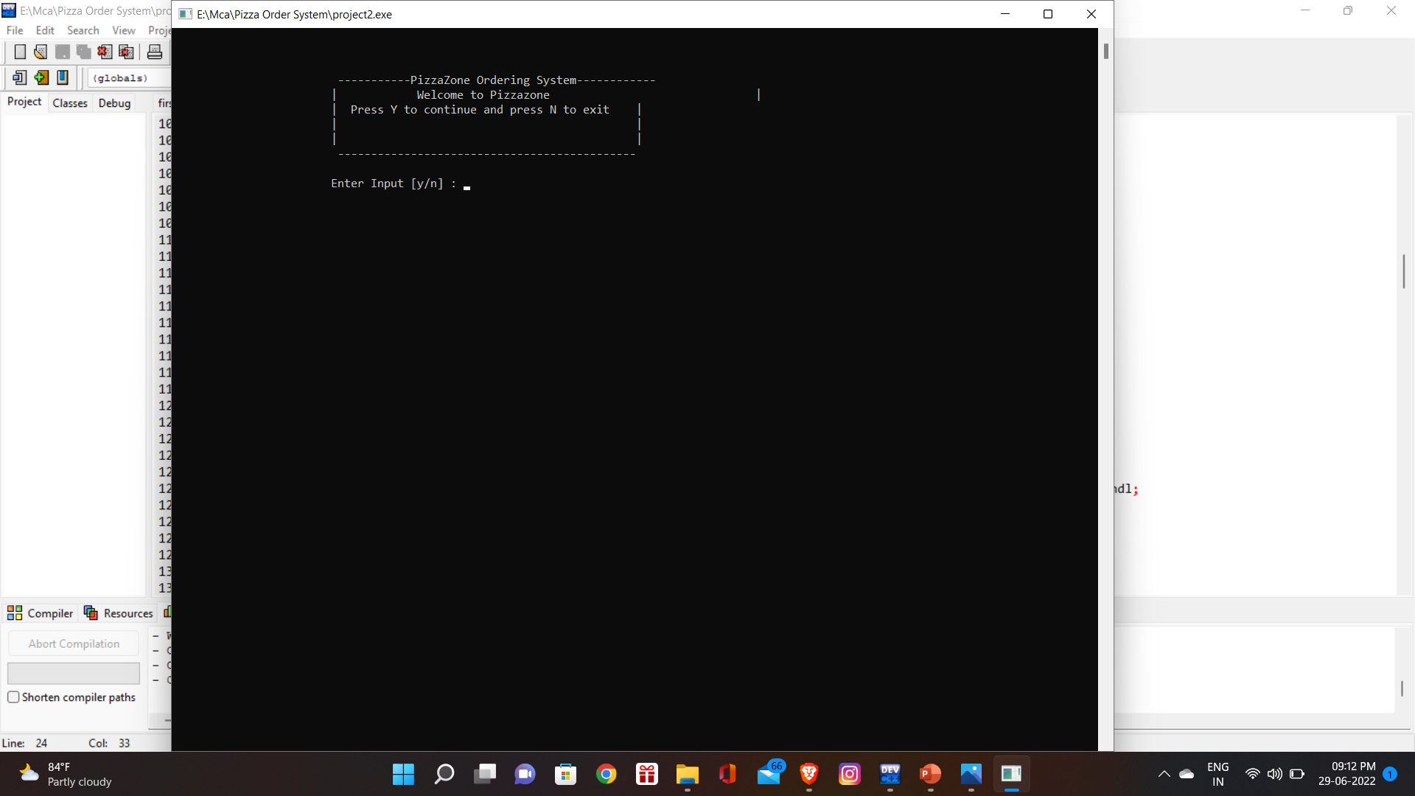
Output
Welcome Screen
Main Menu

Slide 12

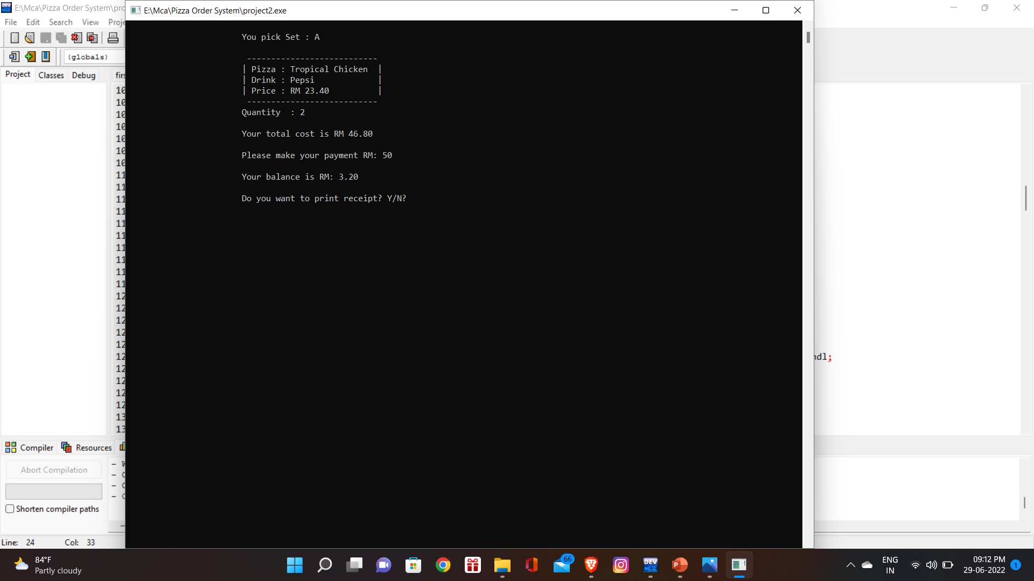
Choose
1
Choose
2

Slide 13
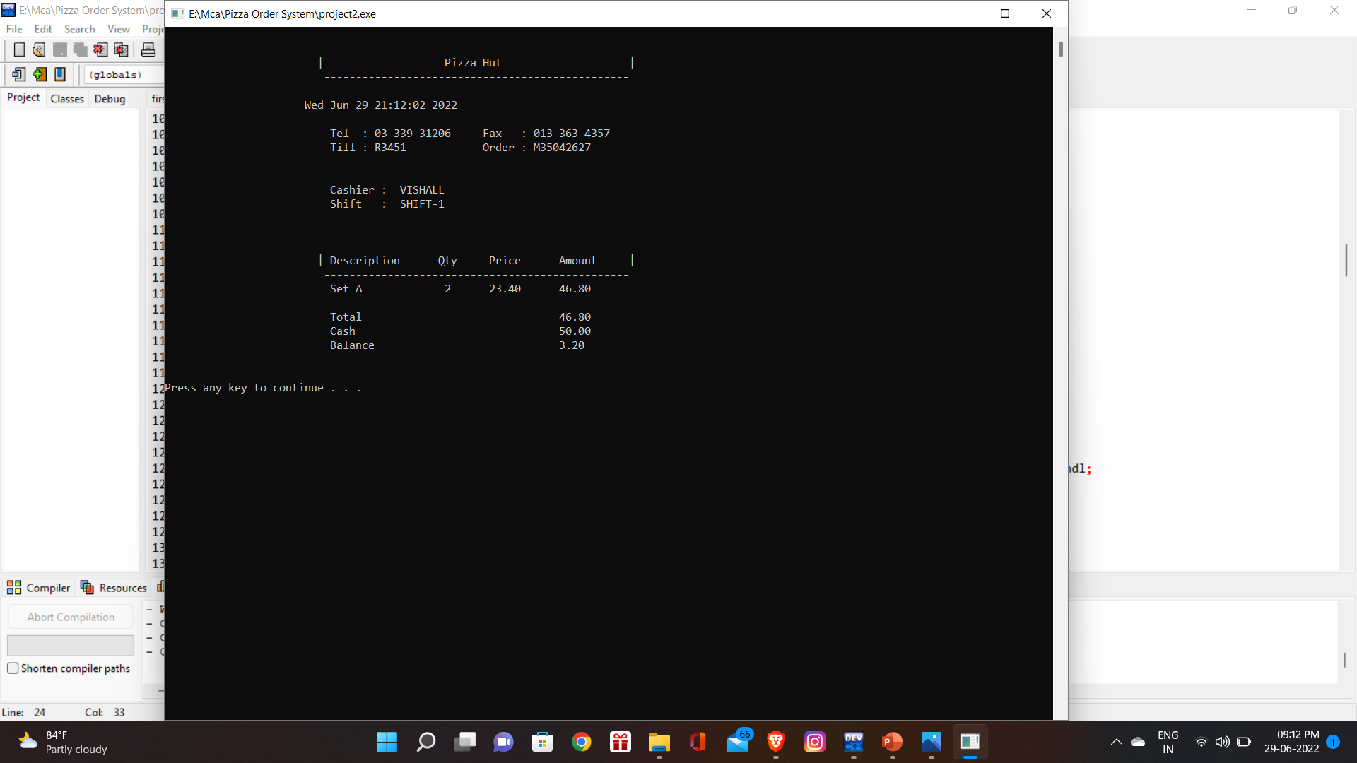

Billing System

Slide 14
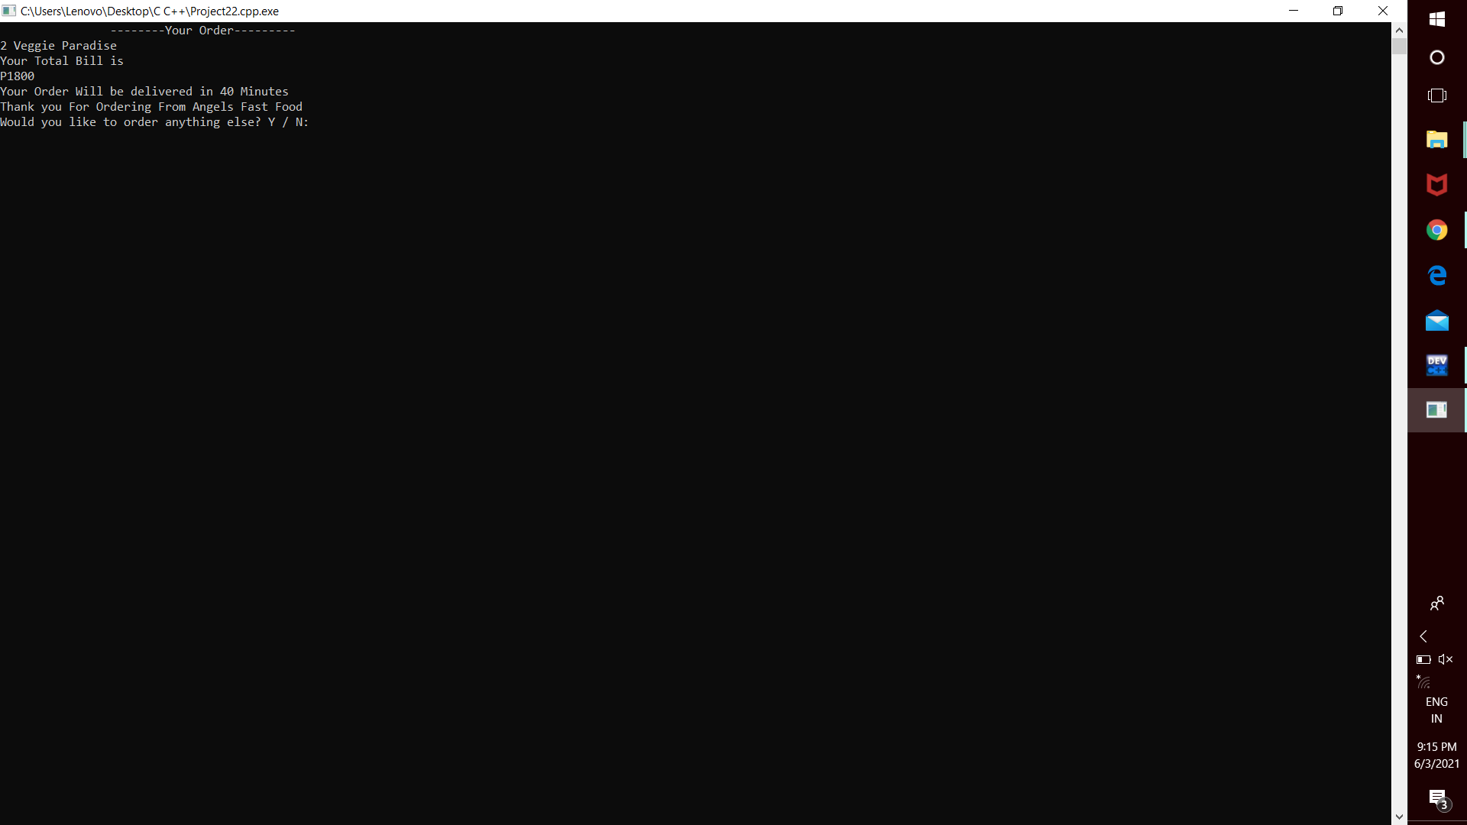
Billing System

Slide 15
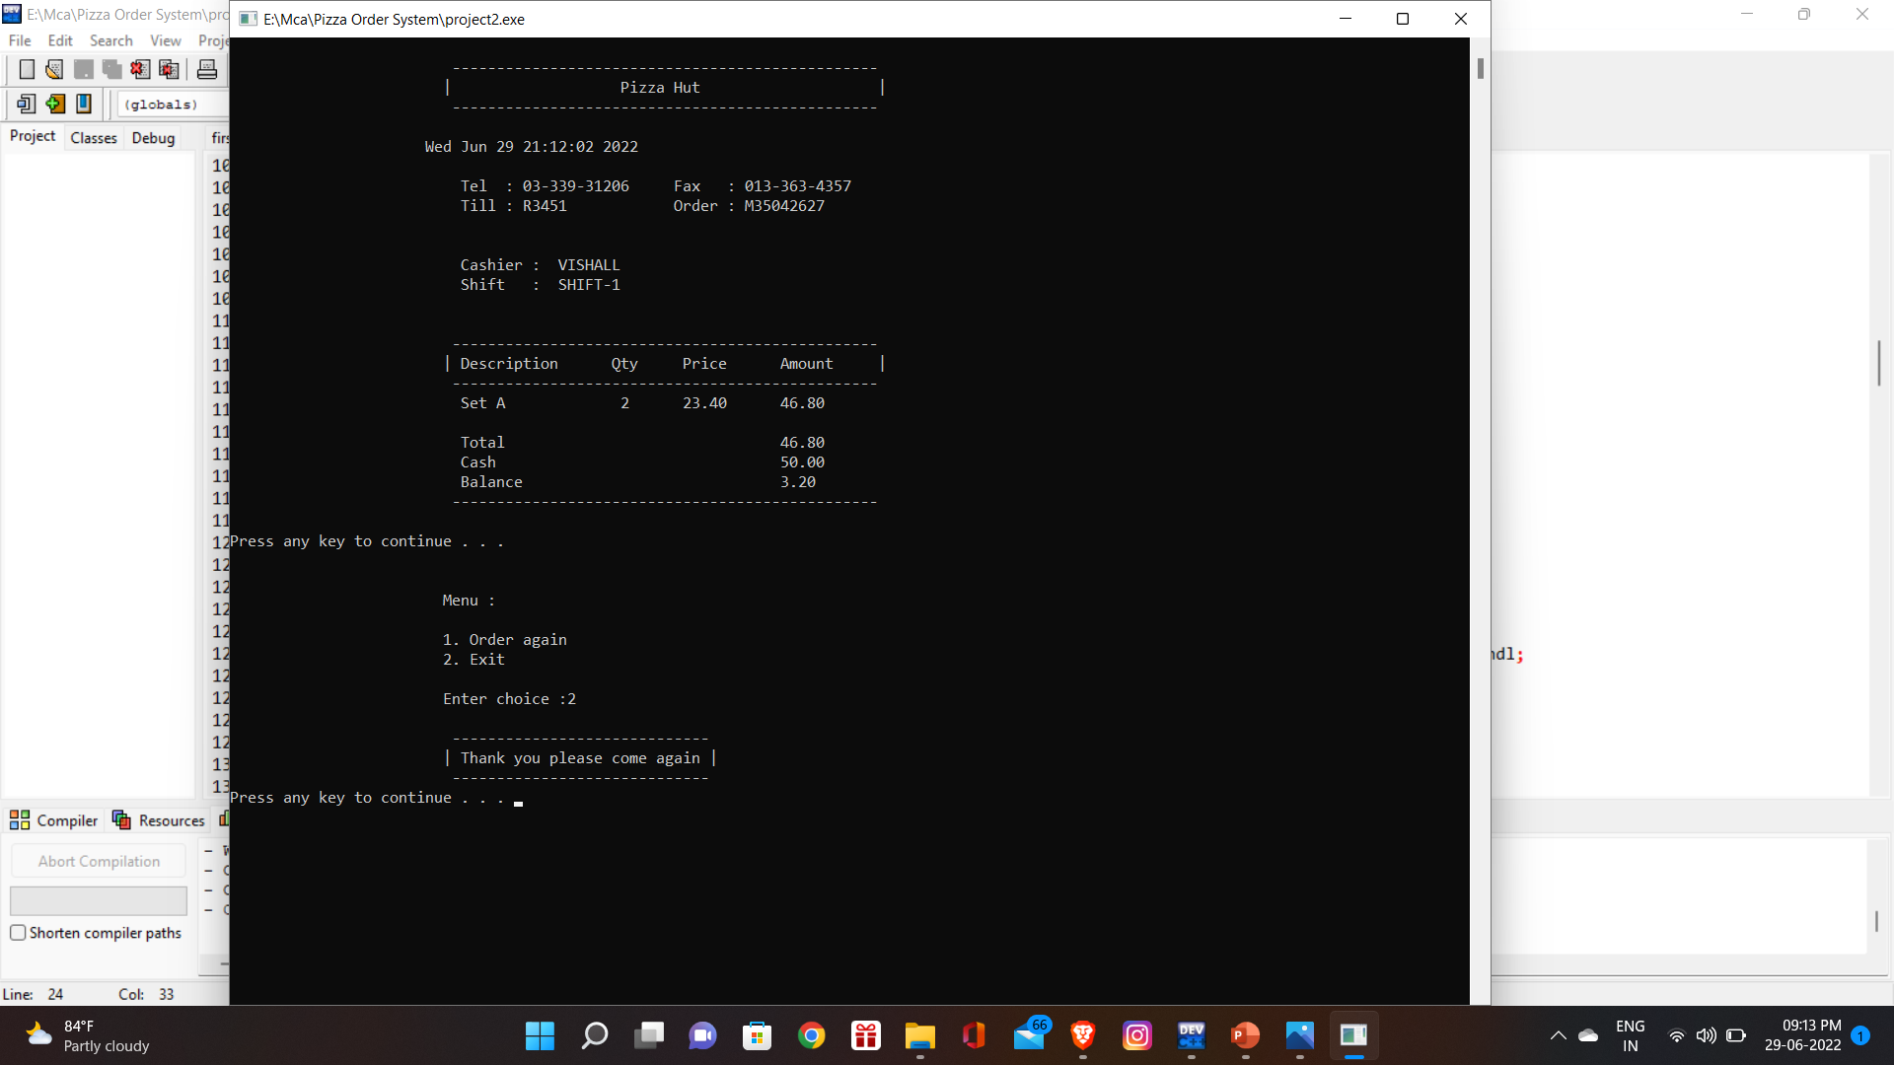

Slide 16
Testing
To build up our project We use Software Testing Process for executing a program with the intent of finding errors that is uncovering errors in a program makes it a feasible task and also trying to find the errors (whose presence assumed) in a program. As it is a destructive process.

Slide 17
Conclusion
Advantages
Limitation
This system reduces manual work.
Keep all records of Pizza and billing.
Easy for the customer to calculate proper bill.
No delay for orders.
Easy for the customer to find their favourite items in menu.
User can get report in some format only.
User won’t able to change the skin or any functionality of application.
All the food order details like food items are constant.
Customer can place only one order at a time.

Slide 18
Enjoy Your Food
Thank You
By:
SHIVAM SAINI

